Slide 1
Piskadera Project Presentation
A Dynamic Vision for Curaçao's Luxury Future

Slide 2
Introduction
The Piskadera Project is a blend of luxury, sustainability, and innovation. It redefines residential and recreational living in Curaçao.

Slide 3
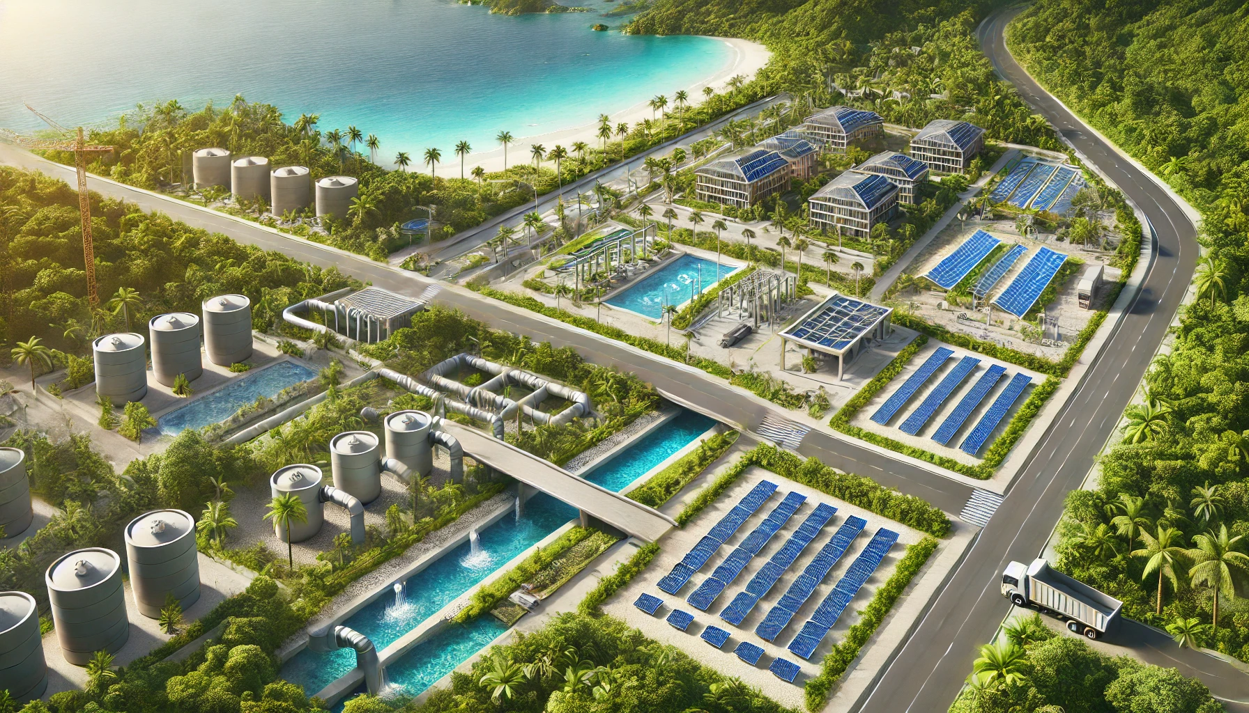
Sector 1: Infrastructure Development
- Sustainable transport networks.
- Renewable energy integration.
- Eco-conscious waste systems.

Slide 4
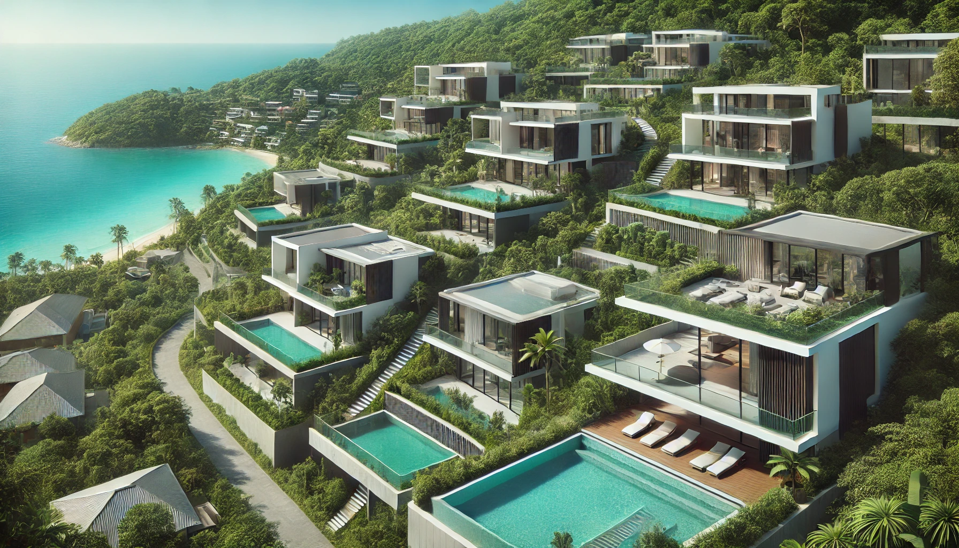
Sector 2: Residential Development
- Modern villas with ocean views.
- Smart homes and eco-friendly materials.
- Community-focused amenities.

Slide 5
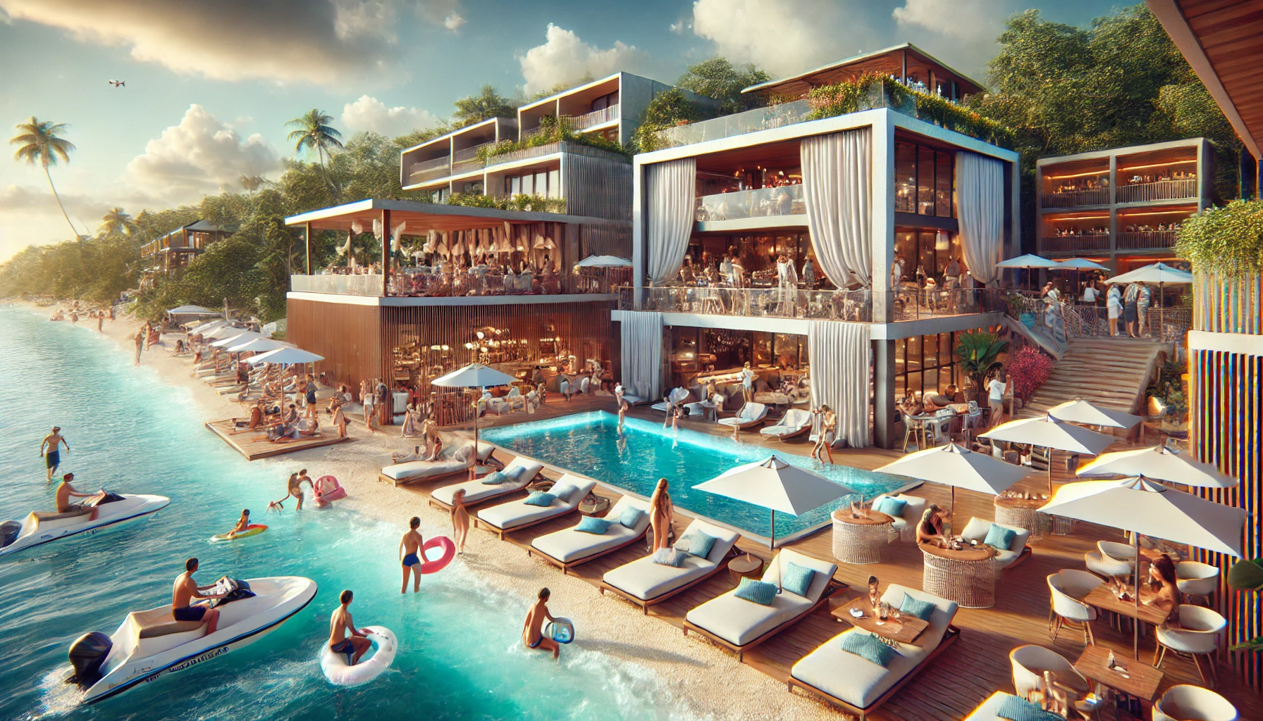
Sector 3: Beach Club
- Upscale beach club with cabanas.
- Water sports and fine dining.
- Vibrant social spaces.

Slide 6
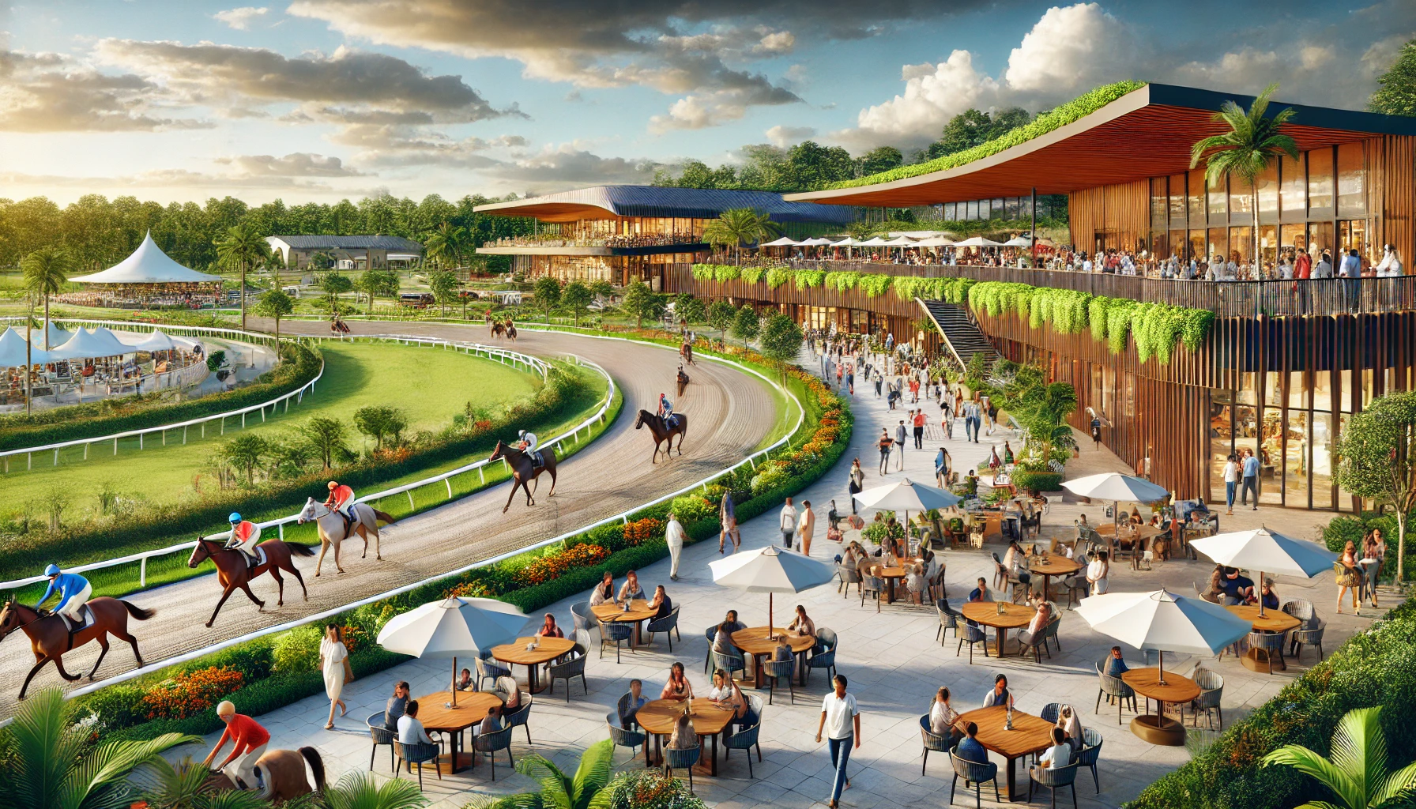
Sector 4: Recreation
- Horse racing park.
- Botanical gardens.
- Community hiking trails.

